Slide 1
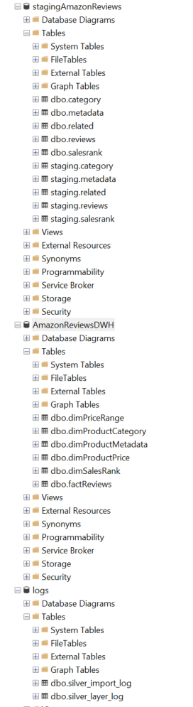
Infrastructure
3 databases
Staging/silver_layer: bring data from online file via python
2 schemas, staging and dbo.
Upload data to staging, then merge into dbo
DWH/gold_layer: dim/fact structure
Only 1 schema. Right now, we drop and recreate the tables every time. → Can go with incremental load if necessary
25_view_layer. Views on top of dbo schema to make adding calculated columns easier. Model queries from 25_view_layer.
Logs
Logging anything that we can regarding the upload process, either in python or through user stored procedures

Slide 2
Ingestion
Python ingest, C# was not dealing well with .json.gz files.
Really versatile with data frame objects, manipulation of heavy data sets through pandas
Drawback is currently we are doing row by row insert, which needs to be optimized. Look into pyodbc.fast_executemany / pyspark
Already manipulate the data into 6 distinct data frames. Inserting these in their respective staging tables in staging db.

Slide 3
ETL
Structure of stored procedure handling transformation from staging to DWH layer.
If tSQL cannot handle some business rules, possibility to go back to python, pull data, transform then insert
Spreads jobs, which is not ideal for maintenance
Drop and reload factTables, supports change of table structure easily while devlopping and first phase of acceptance.
Change to incremental load in the future, not timestamp to rely on for metadata though.

Slide 4
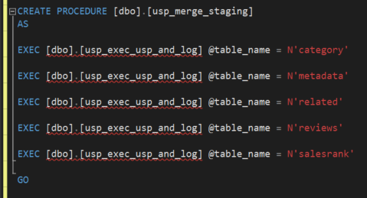
Orchestration
All flows in stored procedure
Ease of modification
Possibility to keep repository of all usps
Orchestration through SQL server Agent and jobs
Possible to call multiple stored procedures that would call extra stored procedures (eg usp_merge_staging).
Bit more obscure than SSIS, but less maintenance heavy. As long as we are on the same server it should not be an issue.

Slide 5
Logging
Logging python execution errors in database to backtrack more easily. Isolated most of the components to ease troubleshooting.
Logging rows inserted and merged to track if ingestion is lacking on some specific days. Only able to do that after a few weeks as we need to build history.

Slide 6
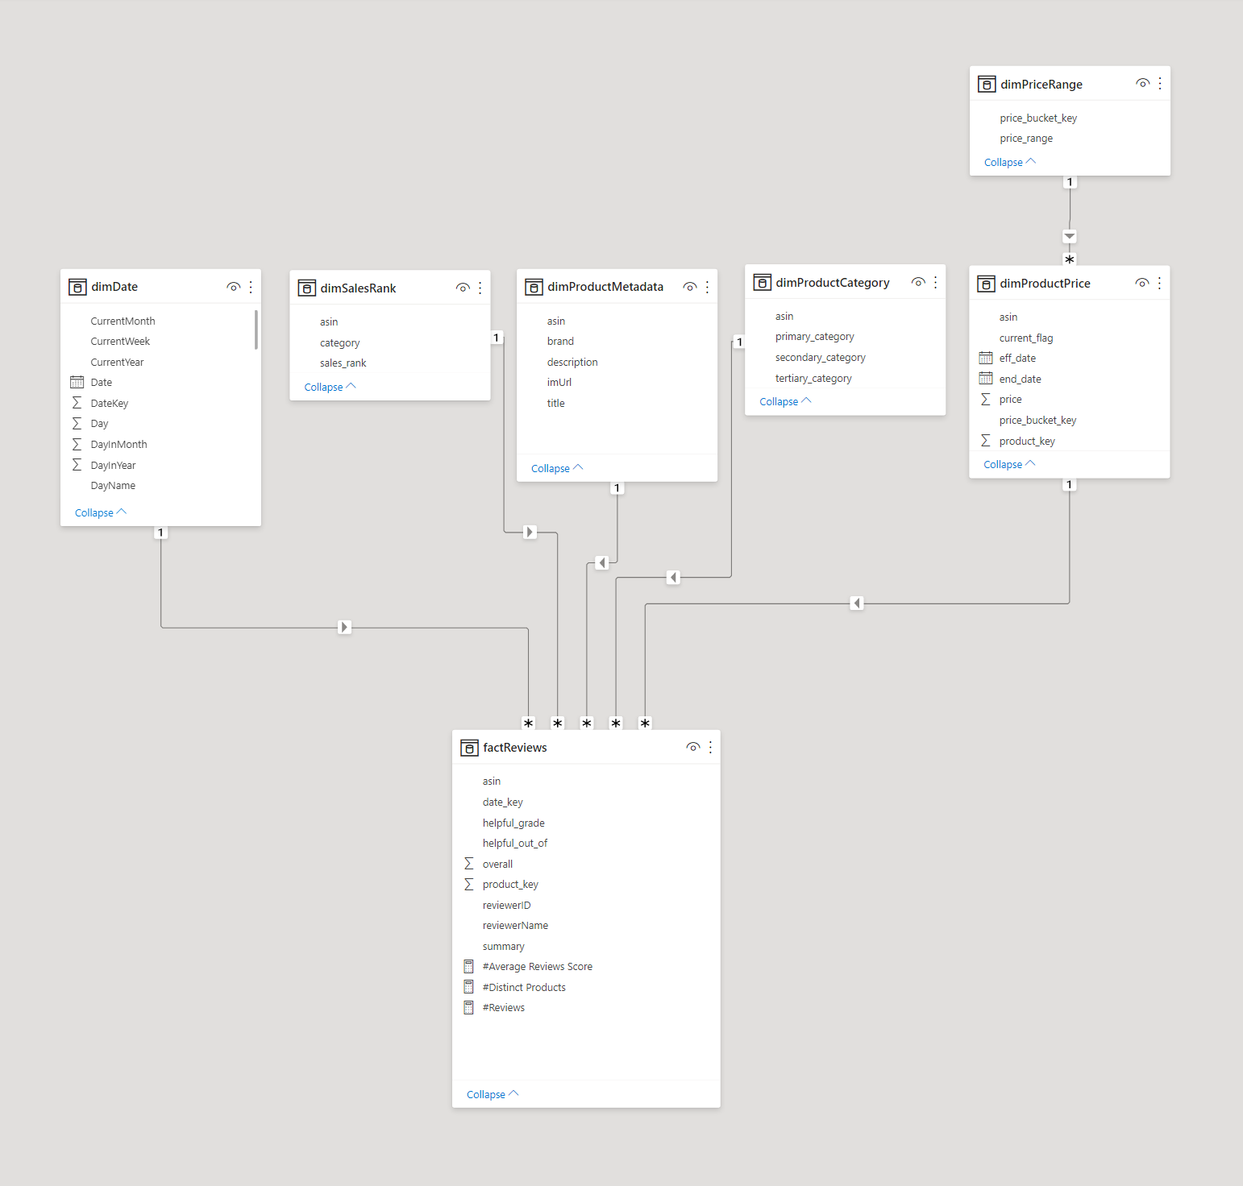
Final Model
dimSalesRank: coming from salesrank field from source.
dimProductMetadata: all flat fields from source, plus a price key for dimPriceRange
dimProductCategory: Only holds details for the first category from input file. Primary/secondary/tertiary determined based on order in source dictionary.
dimPriceRange: Holds buckets for price. Key generated by passing price through log function. Prevents having to join/lookup.
dimProductPrice: SCD Type 2, holding the price of any item, changing through time. Had to create a separate product_key for that.
factReviews: holds the review data minus the text, since there is no value in bringing that over for now

Slide 7
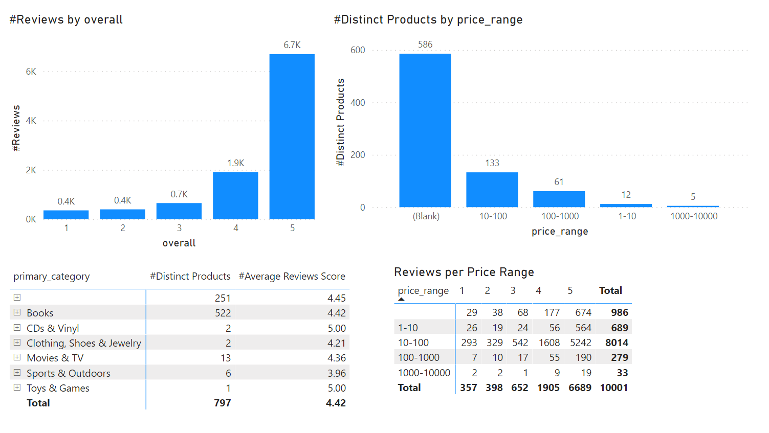
Visual examples

Slide 8
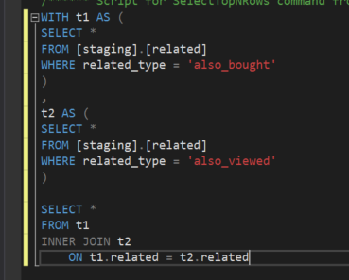
Also_bought / also_viewed
Kinda confused about that one, did not import related to dimensional model, as seemed un-necessary. Can run the following query:

Slide 9
Optimizations
Use any kind of distributed computing (pyspark?). Currently built on premise, limited by hardware, will be hard to handle high volume.
Streaming data set for ingestion if access to something better than a flat file?
Right now, no index created, can look into that.
Working with sample data, might be worth looking into some of the merge queries
Working on finding a better source than a compressed flat file

